Slide 1

Shopping
demo

Slide 2
1
Part 01
install
CONTENTS
2
Part 02
about this project
3
Part 03
detail
4
Part 04

Slide 3
Part 01
Install

Slide 4
Install
1、win+R to open CMD
2、cd to the folder path
3、run `npm i` command
2、rename the file named .env.local.ts to .env.local（equal to delete ‘.ts’）
3、run `npm run dev` command
4、open browser and input `http://localhost:3000`
install guide video
https://drive.google.com/file/d/1YUjPuQqzlf9v6FnHqu1Q5ippICT2G8Tx/view?usp=sharing
Click here to add content of the text，and briefly explain you point of view
Click here to add content of the text，and briefly explain your point of view

Slide 5
Part 02
About this project

Slide 6
function
账号相关：注册、登录、修改密码、忘记密码
购物相关：发布商品、重新编辑已发布商品、商品分类筛选、商品详情、购物车、
历史购买记录、历史浏览记录
注意：邮箱验证相关，地址为互联网真实地址，需在互联网登录自己的真实邮箱进行验证，
验证完之后返回localhost地址可以继续操作。
Click here to add content of the text，and briefly explain you point of view
Click here to add content of the text，and briefly explain your point of view

Slide 7
About this project
reason
sell products、try new skills(php mysql)
difficulity
can’t conect to backend
how to solve
finally choose another way
felling

Slide 8
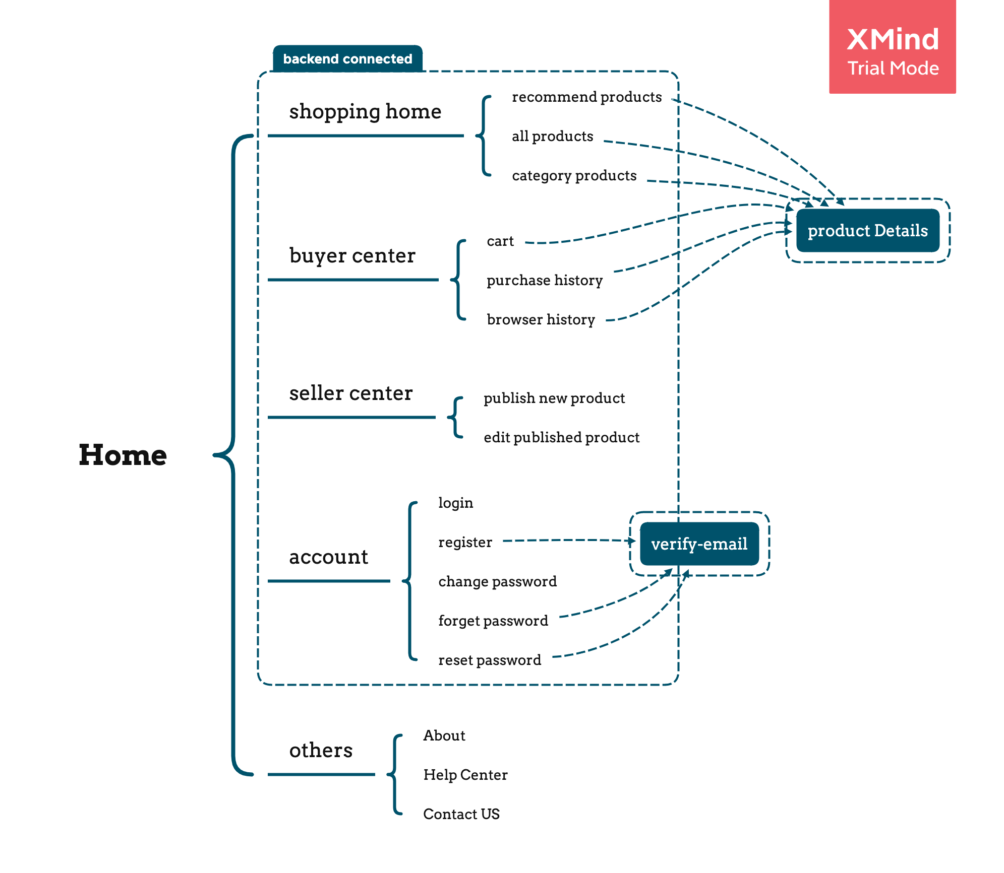
Structure
Click here to add content of the text，and briefly explain you point of view
Click here to add content of the text，and briefly explain your point of view

Slide 9
Part 03
detail

Slide 10
detail
shoping home
1、recommend products
2、all products
3、category products
Click here to add content of the text，and briefly explain you point of view
Click here to add content of the text，and briefly explain your point of view

Slide 11
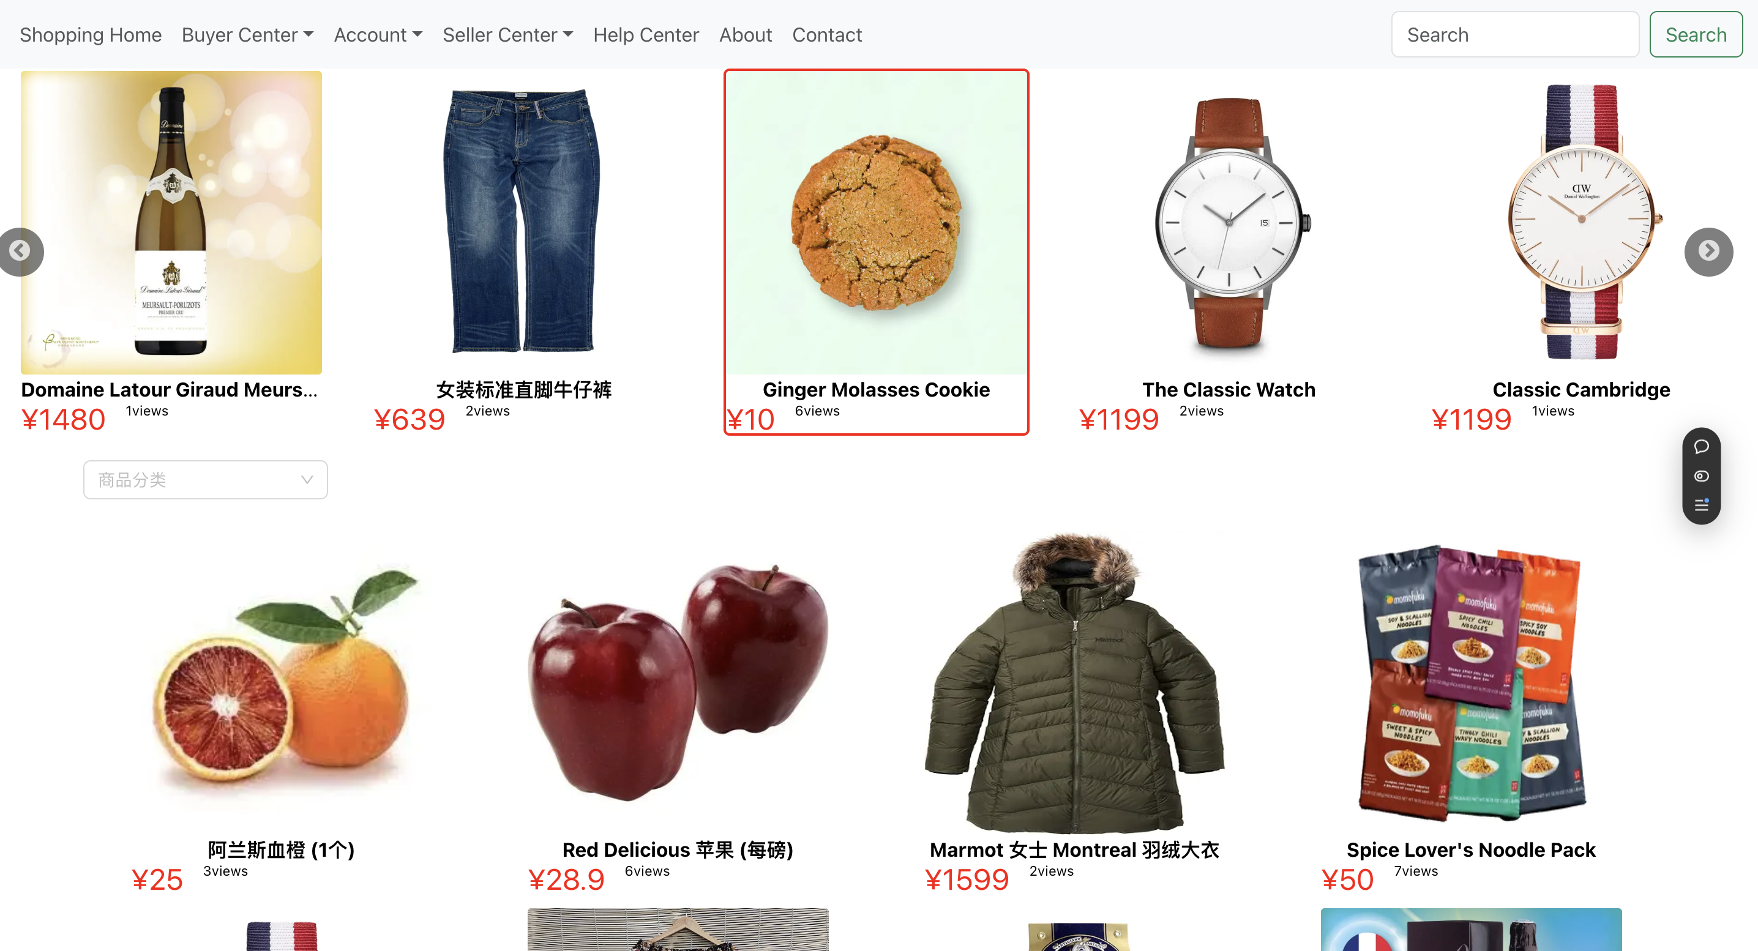
detail
shoping home
1、recommend products
Click here to add content of the text，and briefly explain you point of view
Click here to add content of the text，and briefly explain your point of view

Slide 12
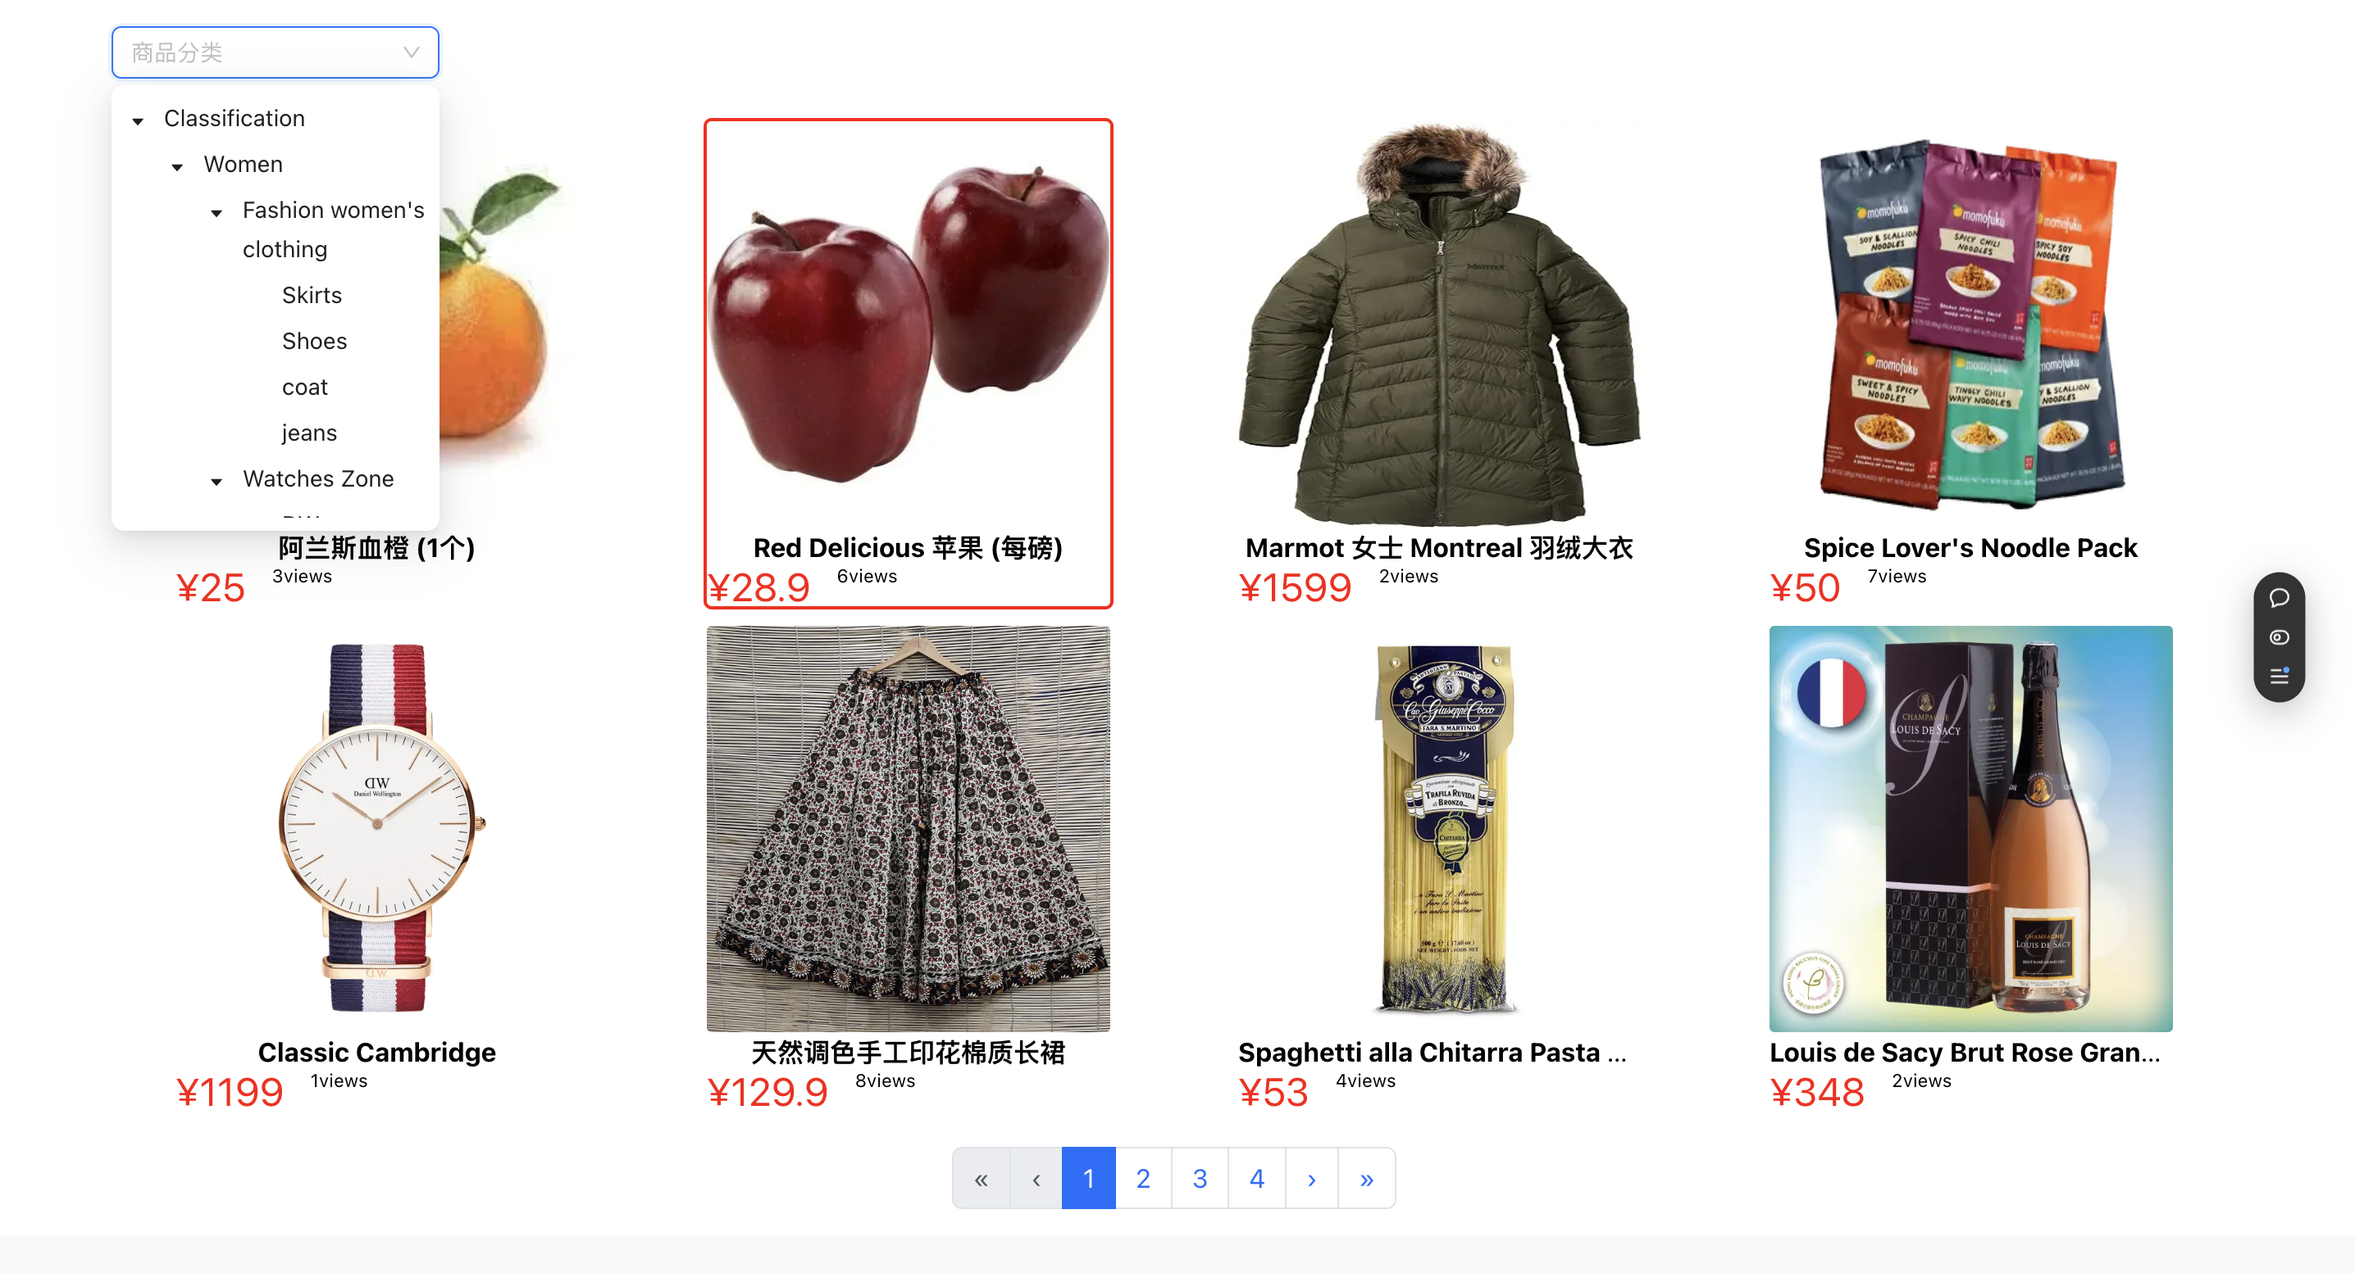
detail
shoping home
2/3、all products / category products
Click here to add content of the text，and briefly explain you point of view
Click here to add content of the text，and briefly explain your point of view

Slide 13
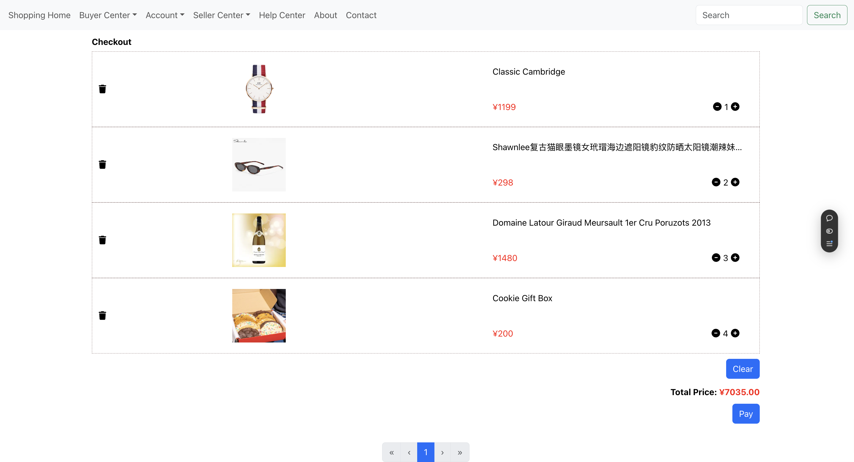
detail
buyer center
1、cart
Click here to add content of the text，and briefly explain you point of view
Click here to add content of the text，and briefly explain your point of view

Slide 14
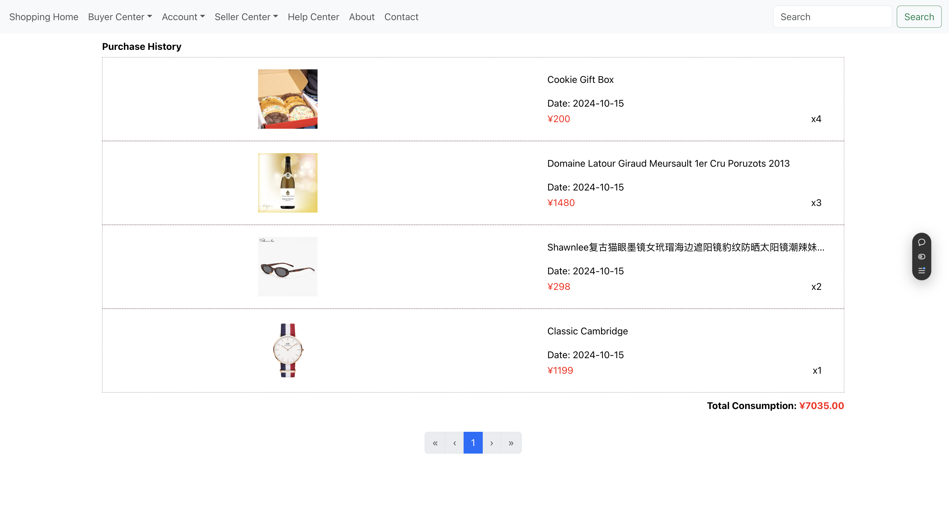
detail
buyer center
2、purchase history
Click here to add content of the text，and briefly explain you point of view
Click here to add content of the text，and briefly explain your point of view

Slide 15
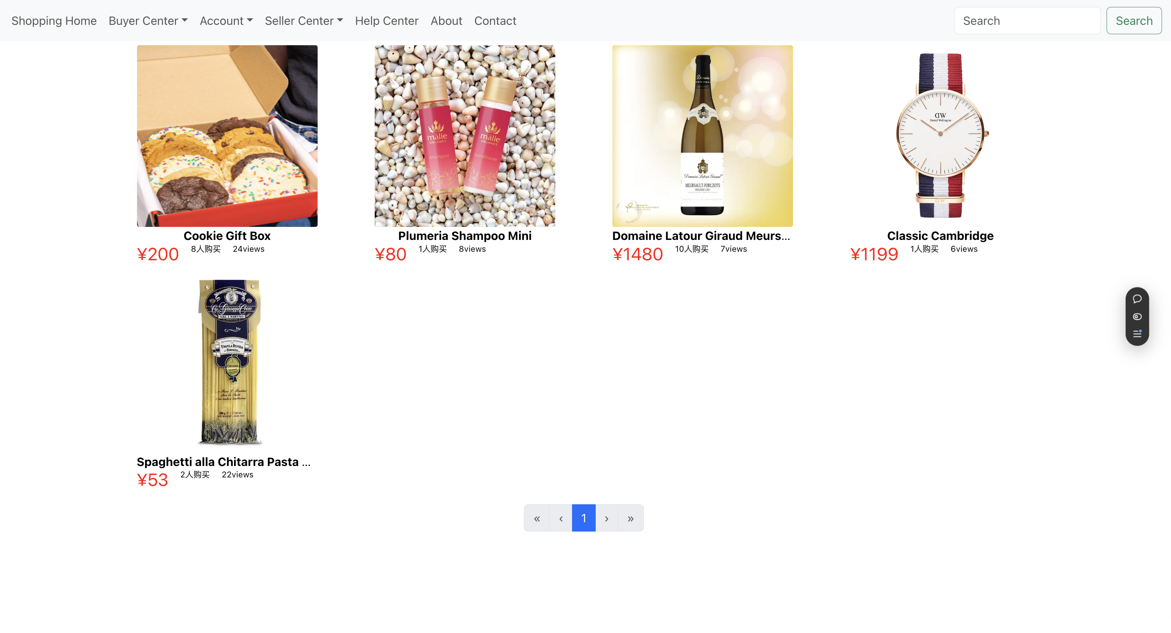
detail
buyer center
3、browser history
Click here to add content of the text，and briefly explain you point of view
Click here to add content of the text，and briefly explain your point of view

Slide 16
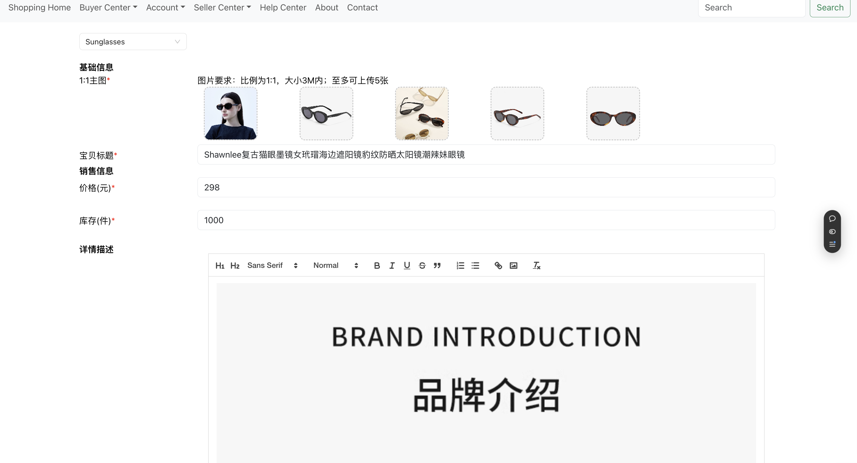
detail
sellerr center
1、pulish product
Click here to add content of the text，and briefly explain you point of view
Click here to add content of the text，and briefly explain your point of view

Slide 17
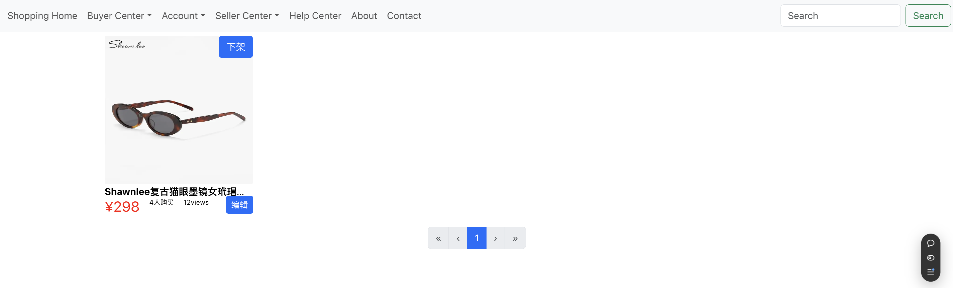
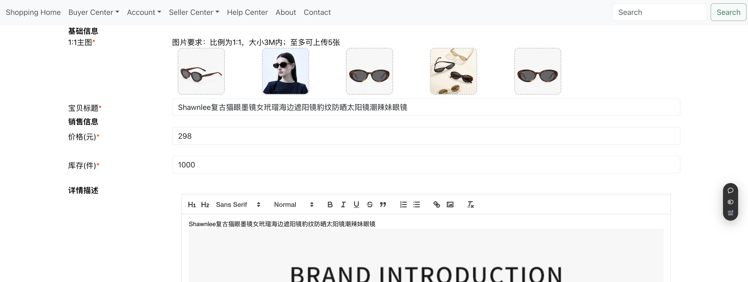
detail
sellerr center
2、edit pulished product
Click here to add content of the text，and briefly explain you point of view
Click here to add content of the text，and briefly explain your point of view

Slide 18
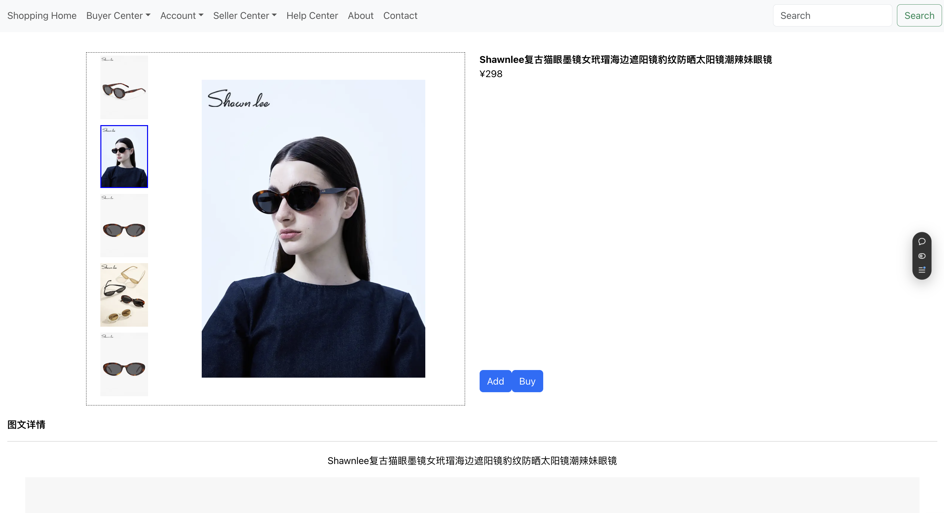
detail
product detail
Click here to add content of the text，and briefly explain you point of view
Click here to add content of the text，and briefly explain your point of view

Slide 19
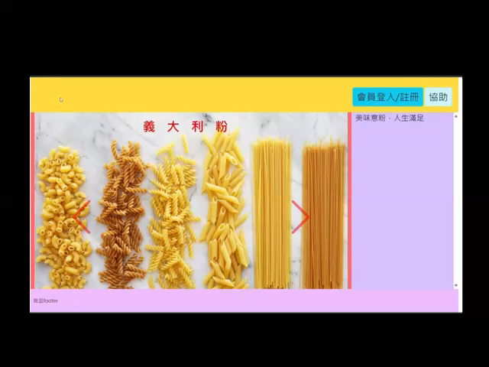
設計網站進入頁面
carousel(走馬燈)介紹產品
推廣文字與走馬燈同步更新
Header文字動畫吸引讀者
Click here to add content of the text，and briefly explain you point of view
Click here to add content of the text，and briefly explain your point of view

Slide 20
設計網站進入頁面
應用Bootstrap CSS生成「走馬燈」效果
應用CSS生成文字動畫效果
應用Javascript更新網頁文字與走馬燈同步
應用CSS控制網頁Layout因應portrait或landscape改變
Click here to add content of the text，and briefly explain you point of view
Click here to add content of the text，and briefly explain your point of view

Slide 21
走馬燈設計方法
<div id="Categories" className="carousel slide carousel-fade" data-bs-ride="carousel">
<div className="carousel-inner">
<div id="wine" className="carousel-item active">
<img src="images/wine.jpg" className="carouselImage d-block w-100" alt="酒類"/>
</div>
<div id="cookies" className="carousel-item">
<img src="images/cookies.jpg" className="carouselImage d-block w-100" alt="曲奇餅"/>
</div>
<div id="shampoo" className="carousel-item">
<img src=“images/shampoo.jpg” className=“carouselImage d-block w-100” alt=“洗髮水"/>
</div>
<div id="pasta" className="carousel-item">
<img src="images/pasta.jpg" className="carouselImage d-block w-100" alt="義大利粉"/>
</div>
</div>
</div>
Click here to add content of the text，and briefly explain you point of view
Click here to add content of the text，and briefly explain your point of view

Slide 22
文字動畫生成方法
<div className="d-flex flex-row justify-content-start">
<span id="blink1">小崗村生活雜貨 </span><span id="blink2">生</span>
<span id="blink3">活</span>
<span id="blink4">美</span><span id="blink5">好</span>
</div>
Click here to add content of the text，and briefly explain you point of view
Click here to add content of the text，and briefly explain your point of view

Slide 23
@keyframes blinkText1 {
0% {visibility: hidden; opacity: 0;}
10% {visibility: visible; opacity: 1;}
}
@keyframes blinkText2 {
0% {visibility: hidden; opacity: 0;}
20% {visibility: visible; opacity: 1;}
}
@keyframes blinkText3 {
0% {visibility: hidden; opacity: 0;}
30% {visibility: visible; opacity: 1;}
}
@keyframes blinkText4 {
0% {visibility: hidden; opacity: 0;}
40% {visibility: visible; opacity: 1;}
}
@keyframes blinkText5 {
0% {visibility: hidden; opacity: 0;}
50% {visibility: visible; opacity: 1;}
}
@keyframes blinkText6 {
0% {visibility: hidden; opacity: 0;}
60% {visibility: visible; opacity: 1;}
}
@keyframes blinkText7 {
0% {visibility: hidden; opacity: 0;}
70% {visibility: visible; opacity: 1;}
}
#blink1{
visibility: hidden; opacity: 0;
animation: blinkText1 10s steps(1, end) infinite ;
}
#blink2{
visibility: hidden; opacity: 0;
animation: blinkText2 10s steps(1, end) infinite ;
}
#blink3{
visibility: hidden; opacity: 0;
animation: blinkText3 10s steps(1, end) infinite ;
}
#blink4{
visibility: hidden; opacity: 0;
animation: blinkText4 10s steps(1, end) infinite ;
}
#blink5{
visibility: hidden; opacity: 0;
animation: blinkText5 10s steps(1, end) infinite ;
}
#blink6{
visibility: hidden; opacity: 0;
animation: blinkText6 10s steps(1, end) infinite ;
}
#blink7{
visibility: hidden; opacity: 0;
animation: blinkText7 10s steps(1, end) infinite ;
}
Click here to add content of the text，and briefly explain you point of view
Click here to add content of the text，and briefly explain your point of view

Slide 24
const destinationBrief = {
"wine":{
"discription" : "對酒當歌，人生幾何？",
},
"cookies":{
"discription" : "我們有超過150款曲奇供你享用",
},
"shampoo":{
"discription" : "選擇適當洗髮護髮產品，呵護你的頭髮",
},
"pasta":{
"discription" : "美味意粉，人生滿足",
},
}
const product_discription = document.getElementById("product-discription")
const carouselCategories = document.getElementById("carouselCategories")
if (carouselCategories != null) {
carouselCategories.addEventListener("slid.bs.carousel", event => {
product_discription.textContent=destinationBrief[`${event.relatedTarget.id}`]["discription"]
})}
Click here to add content of the text，and briefly explain you point of view
Click here to add content of the text，and briefly explain your point of view

Slide 25
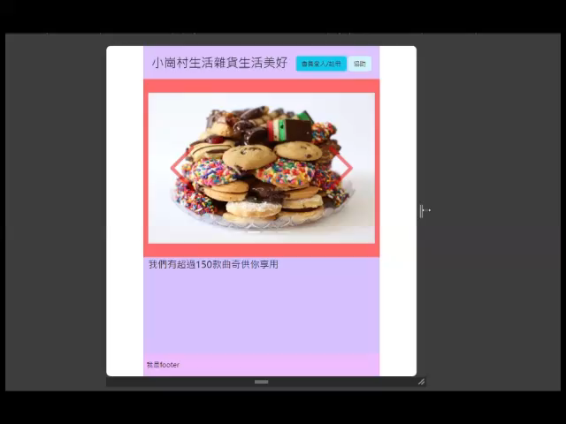
Layout因應portrait或landscape改變
Click here to add content of the text，and briefly explain you point of view
Click here to add content of the text，and briefly explain your point of view

Slide 26
/* layout for portrait orientation, article above section, re-arrange height propotion */
@media screen and (orientation: portrait) {
header {
height: 10%;
}
footer {
height: 7%;
}
#stuff {
height: 83%;
}
section {
width: 100% !important;
height: 65%;
}
article {
width: 100% !important;
height: 35%;
}
}
Click here to add content of the text，and briefly explain you point of view
Click here to add content of the text，and briefly explain your point of view

Slide 27
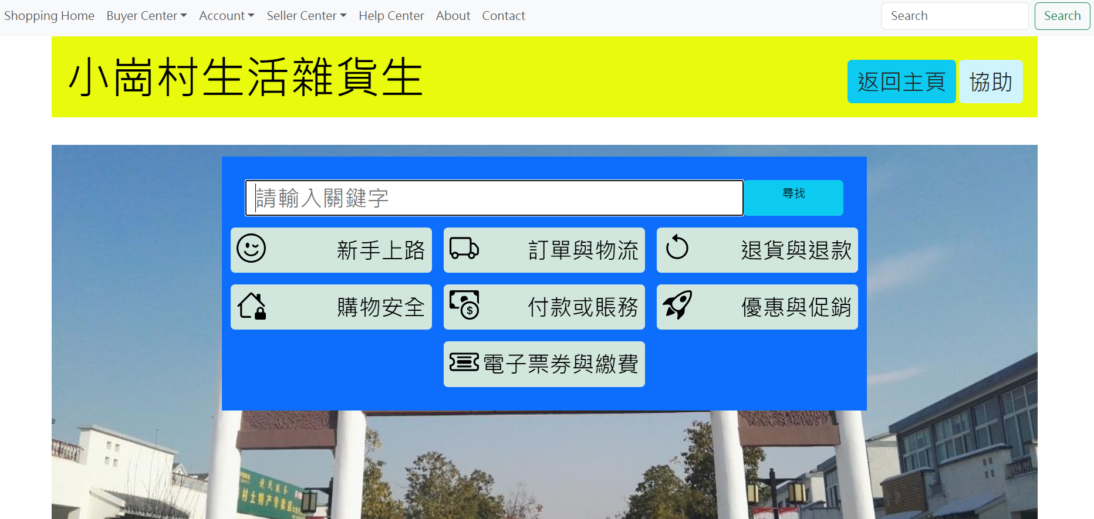
設計用戶協助頁面
Click here to add content of the text，and briefly explain you point of view
Click here to add content of the text，and briefly explain your point of view

Slide 28
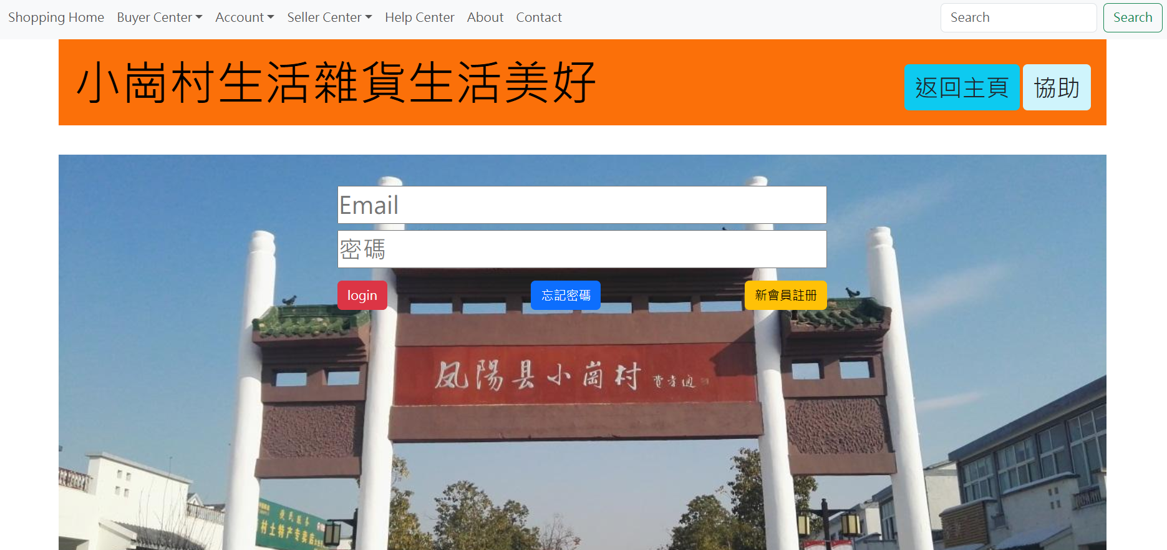
設計用戶登入頁面
Click here to add content of the text，and briefly explain you point of view
Click here to add content of the text，and briefly explain your point of view

Slide 29
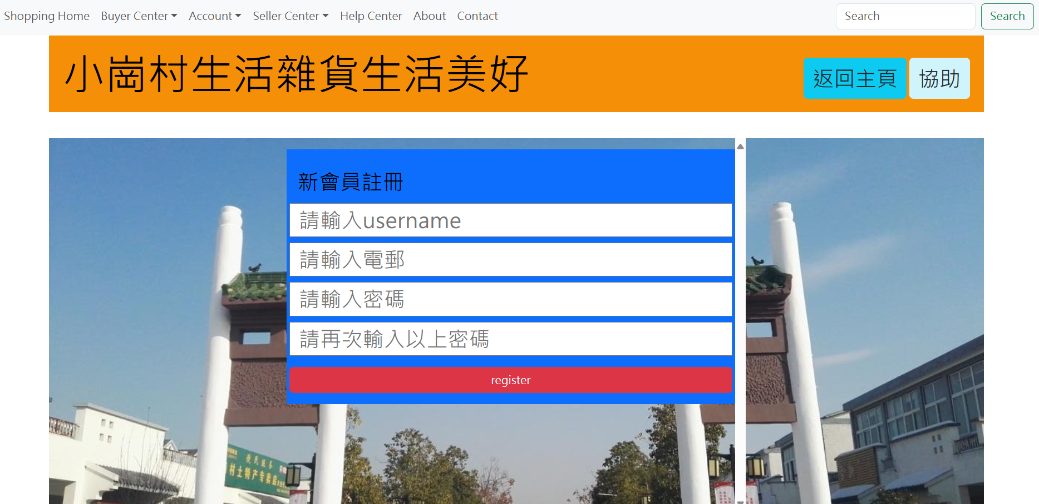
設計用戶註冊頁面
Click here to add content of the text，and briefly explain you point of view
Click here to add content of the text，and briefly explain your point of view

Slide 30
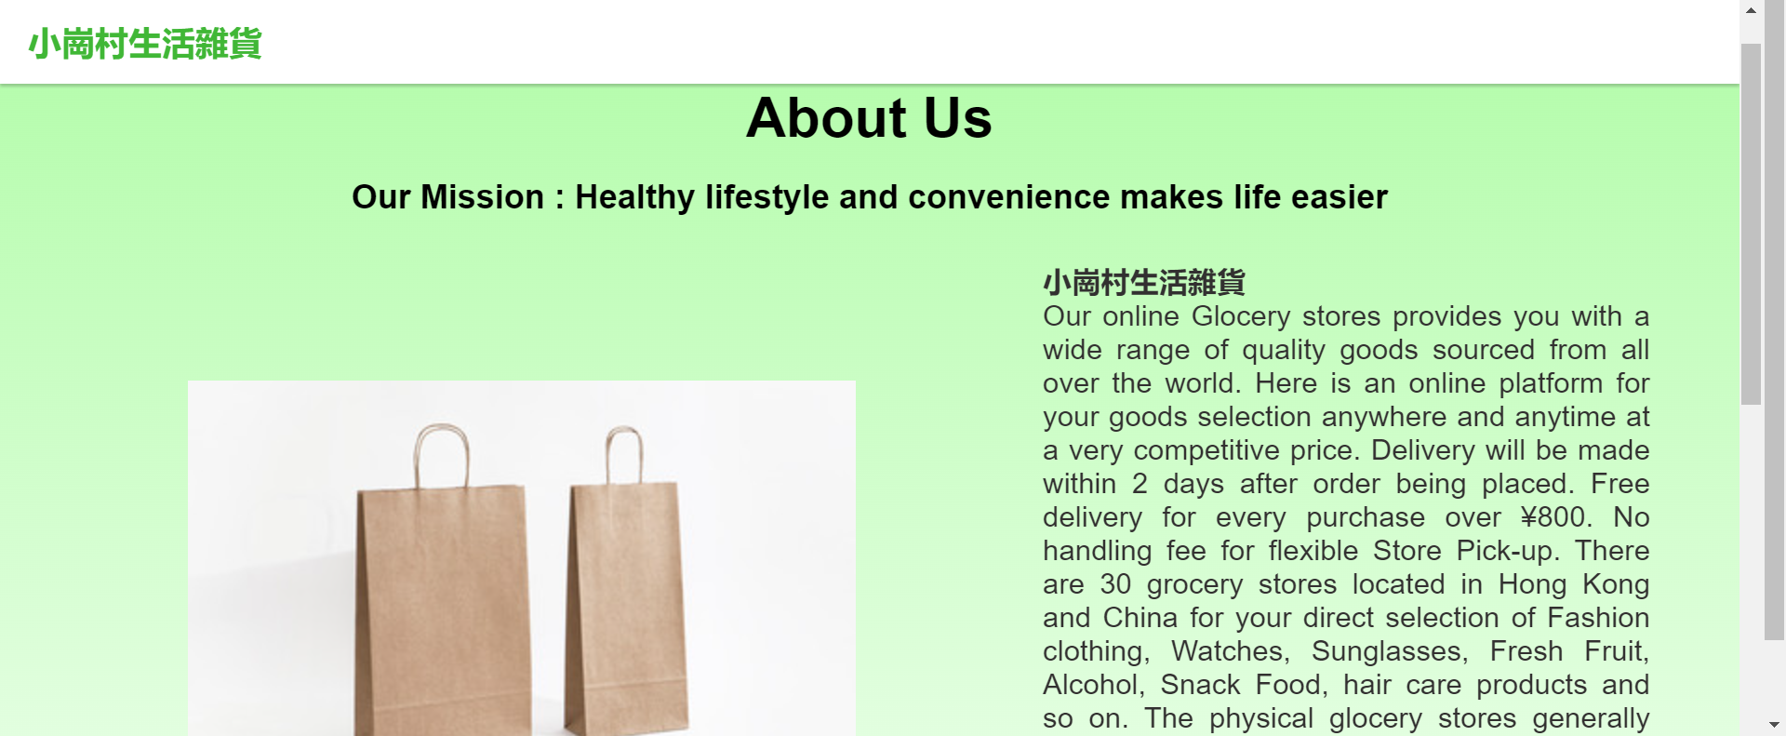
about us

Slide 31
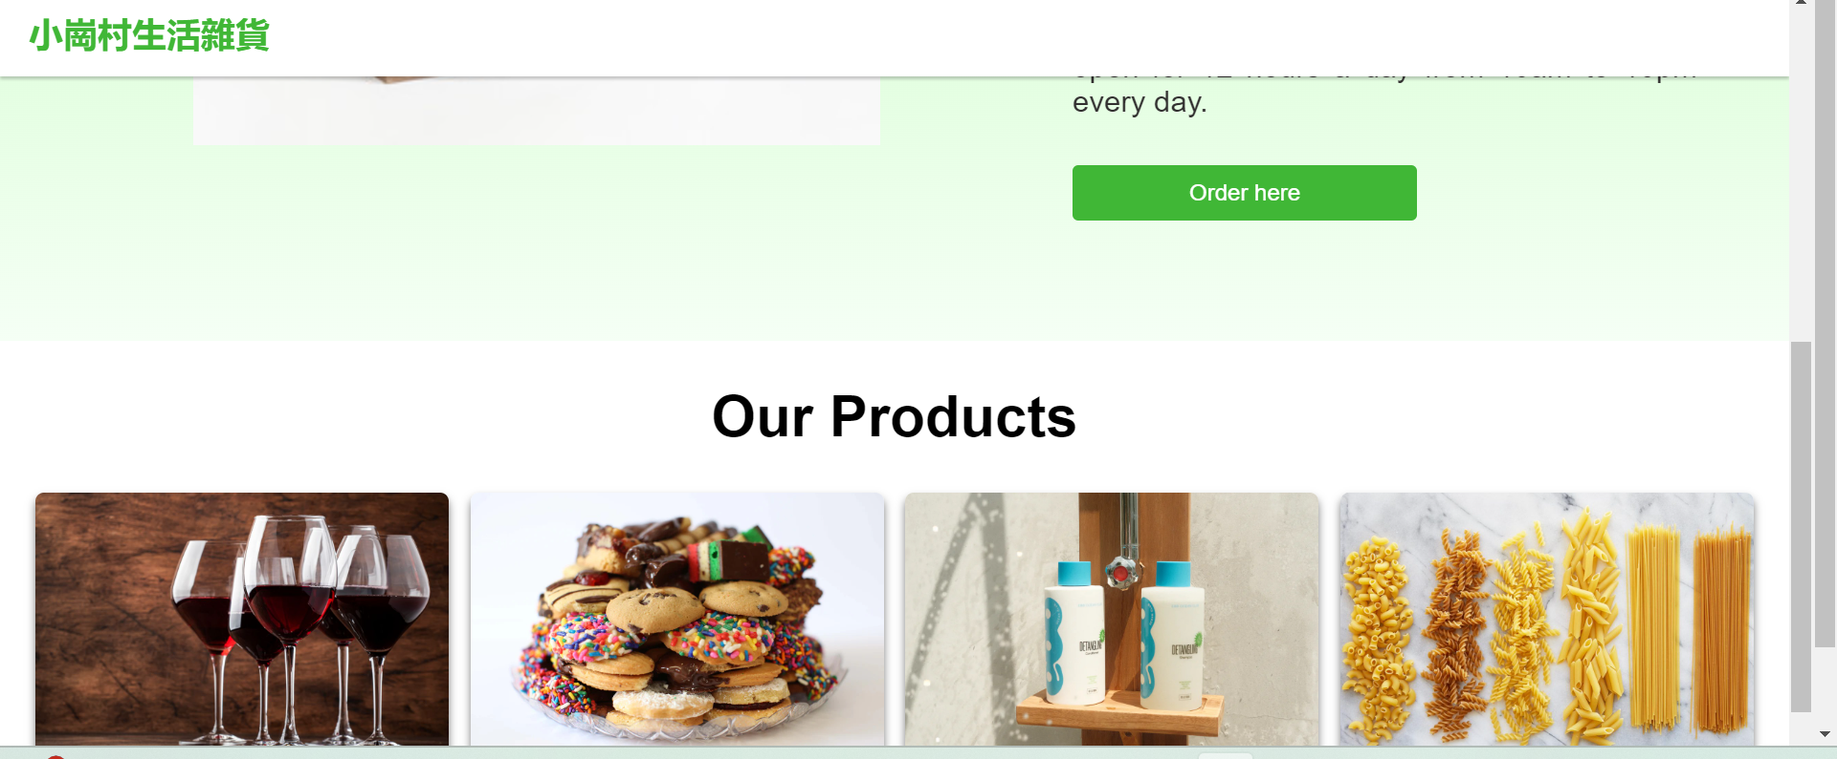
about us

Slide 32
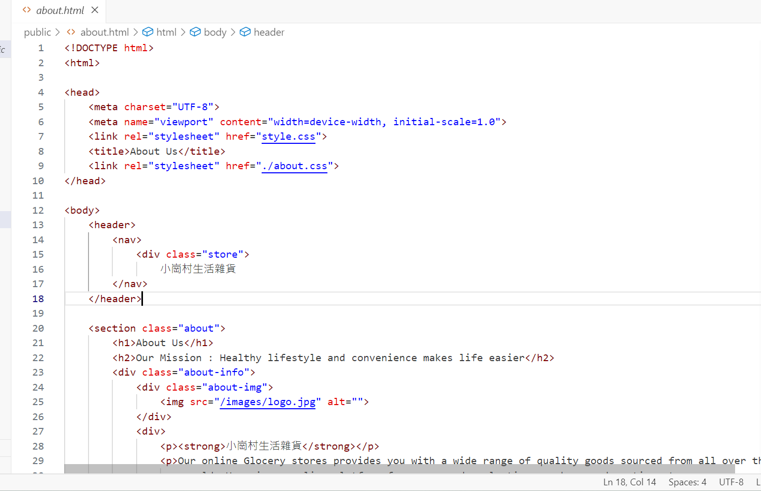
about us

Slide 33
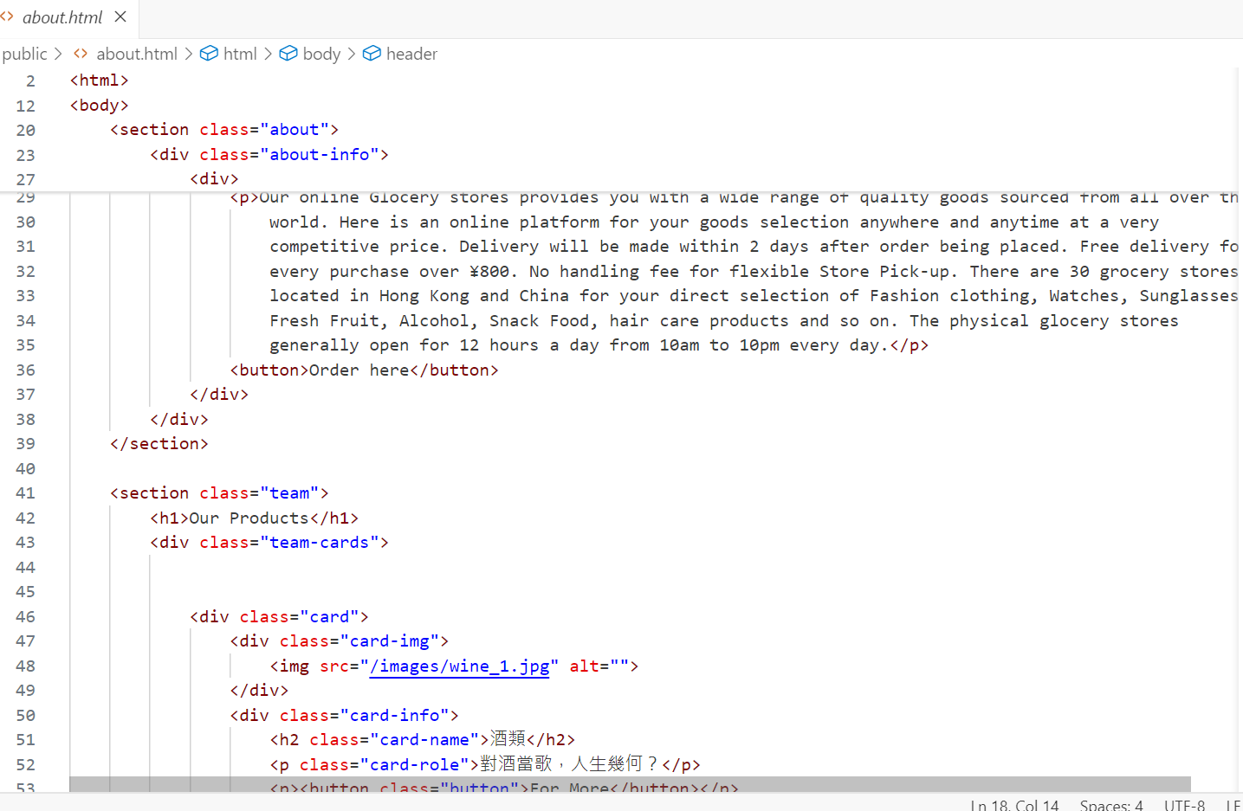
about us

Slide 34
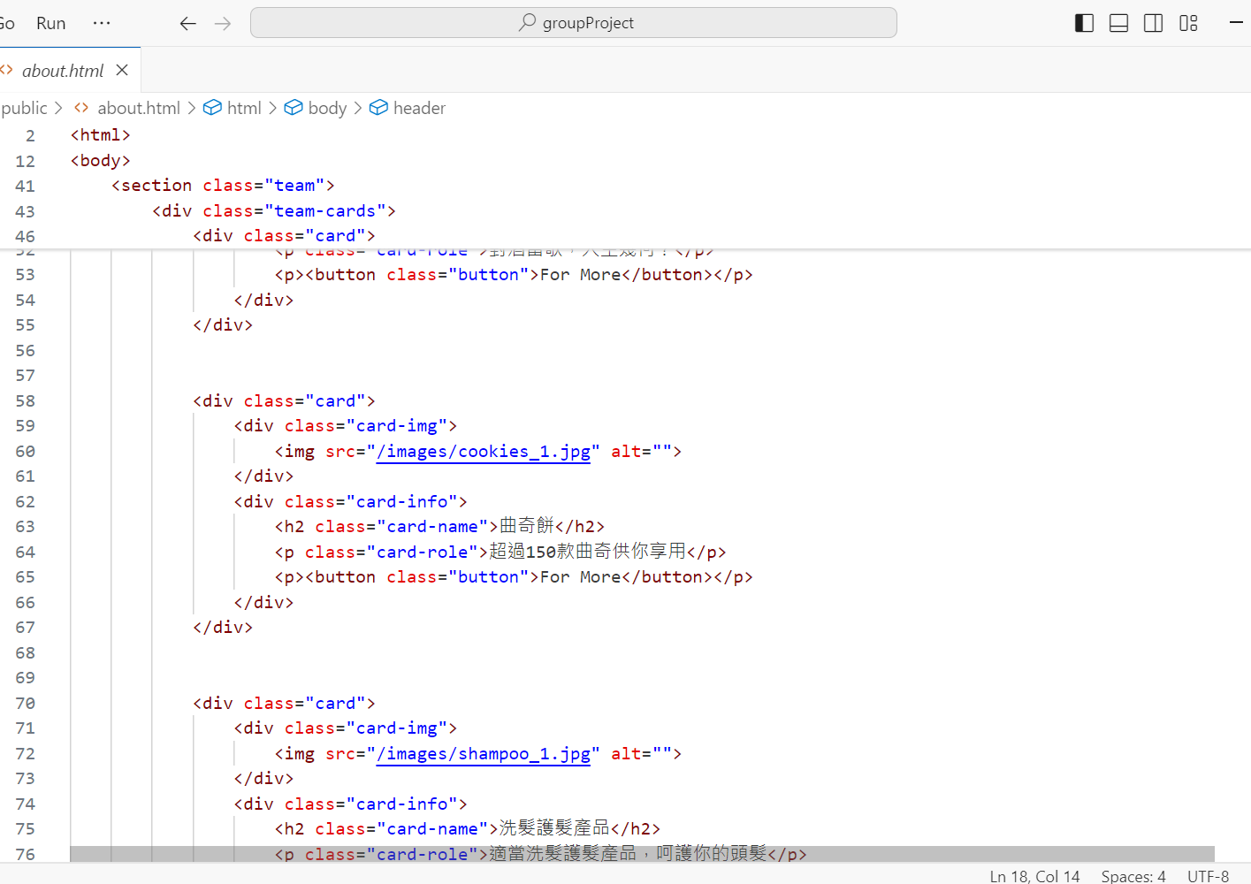
about us

Slide 35
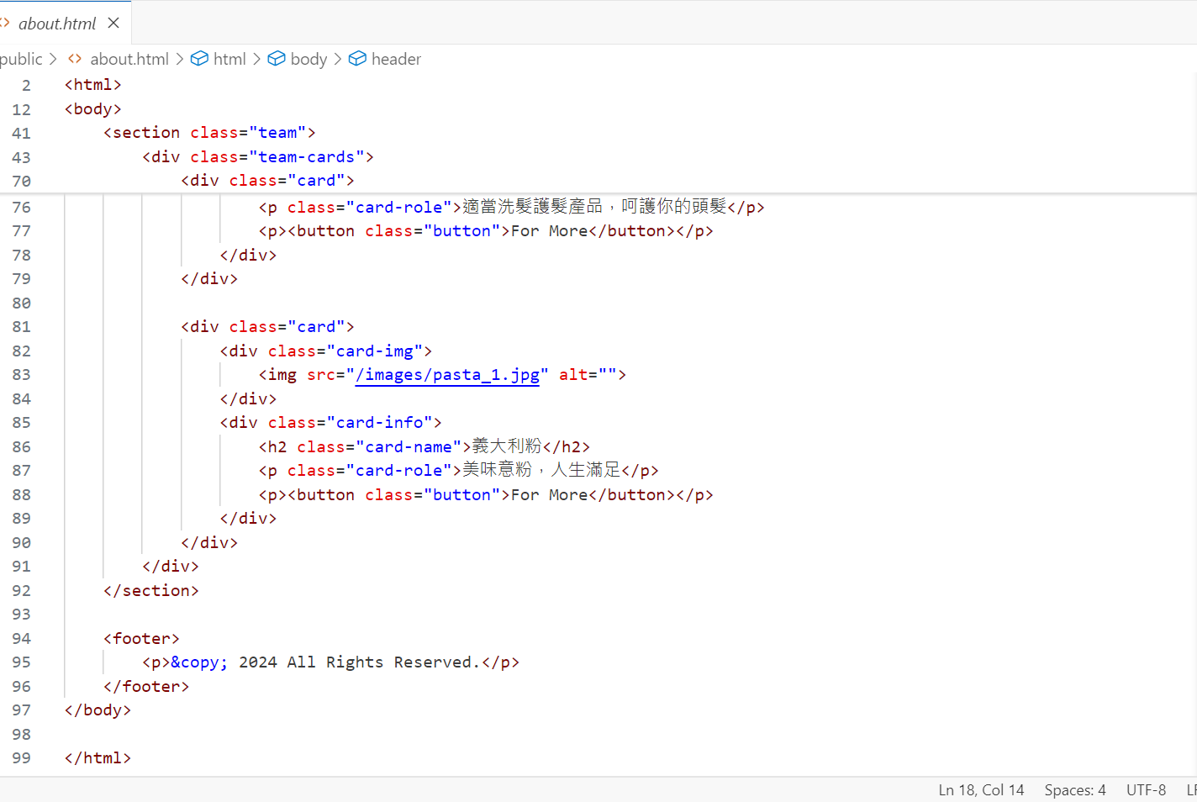
about us

Slide 36
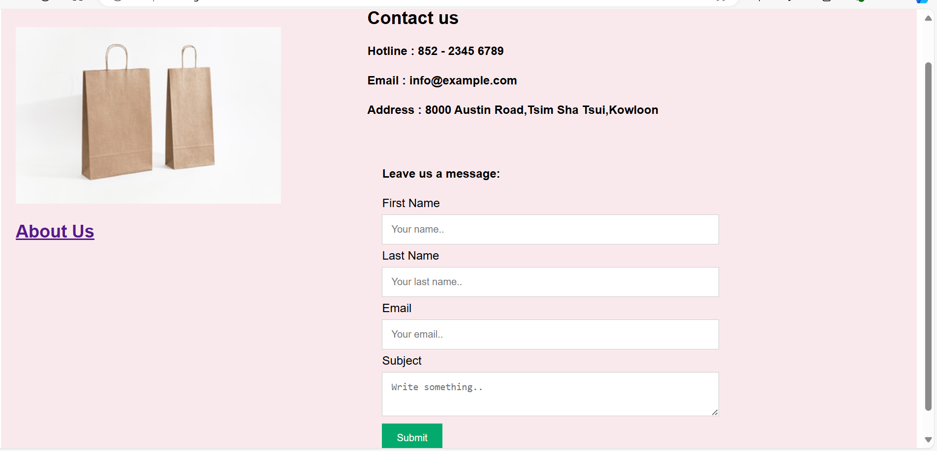
contact

Slide 37
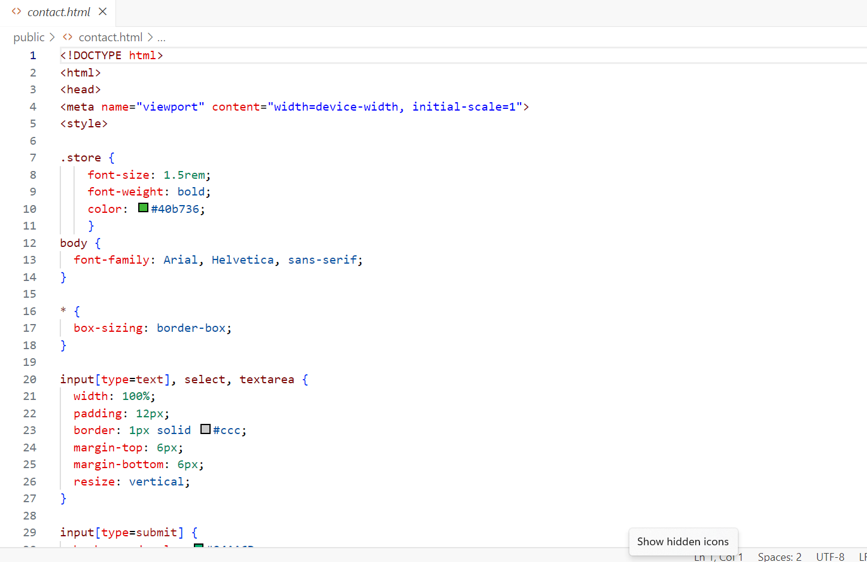
contact

Slide 38
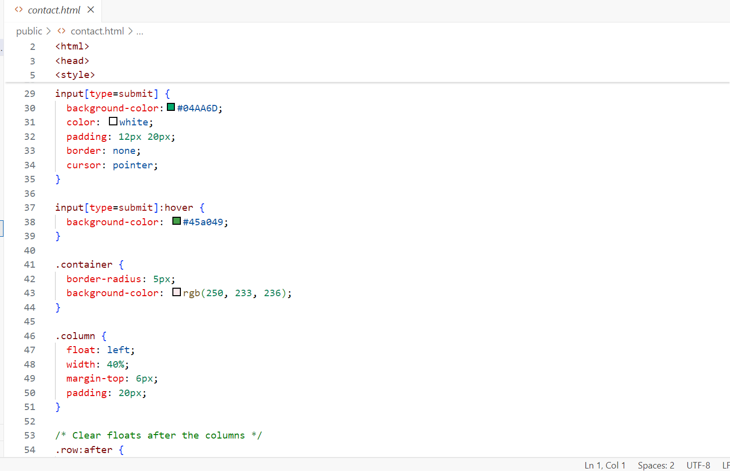
contact

Slide 39
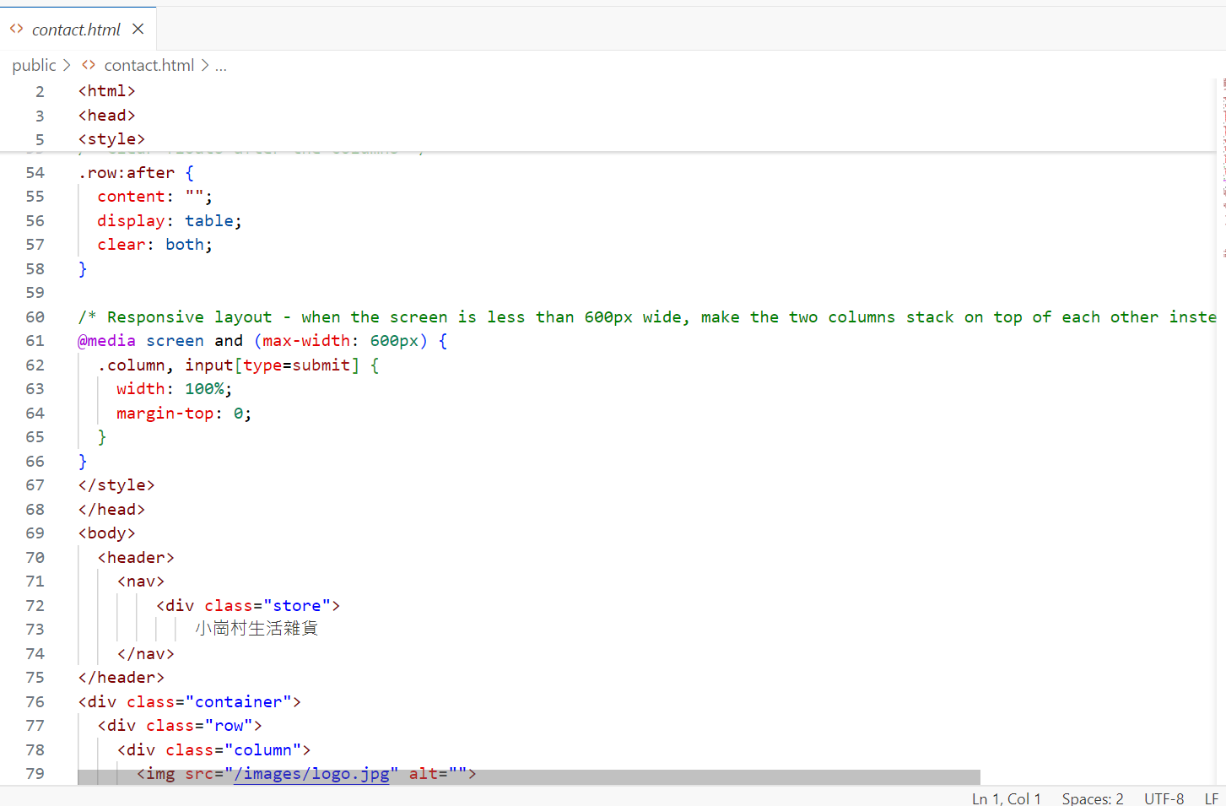
contact

Slide 40
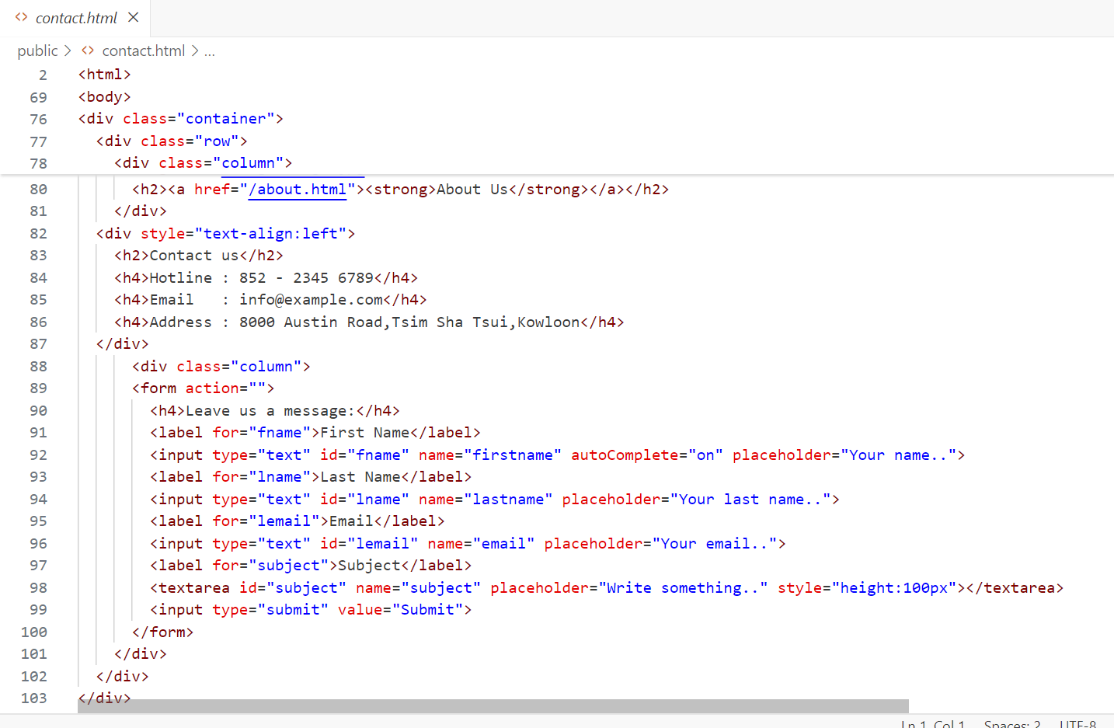
contact

Slide 41
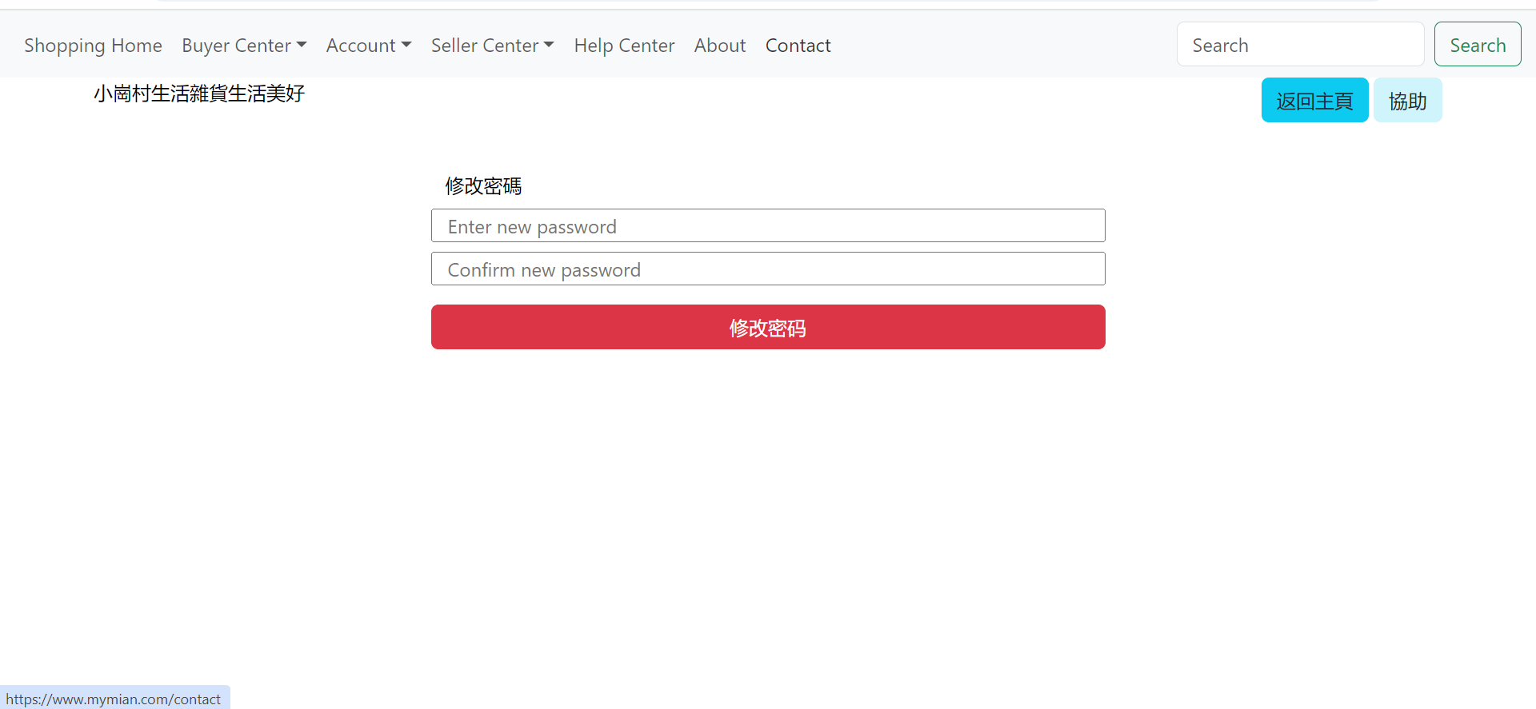
reset password

Slide 42
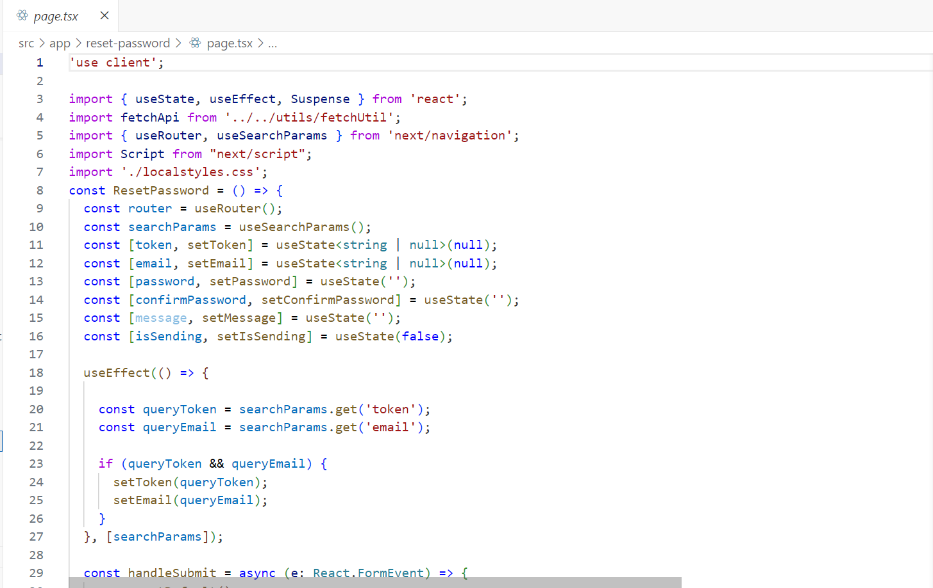
reset password

Slide 43
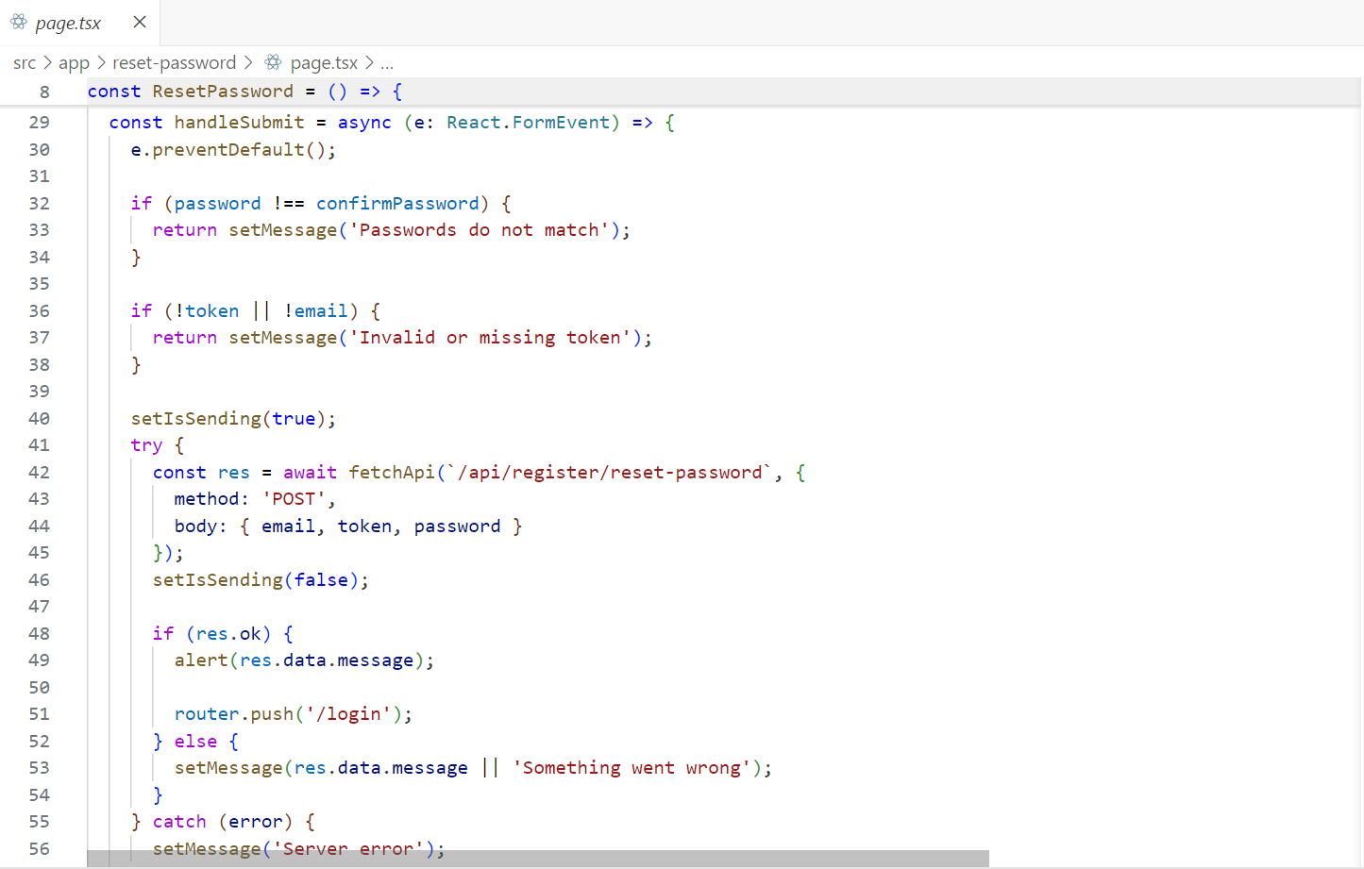
reset password

Slide 44
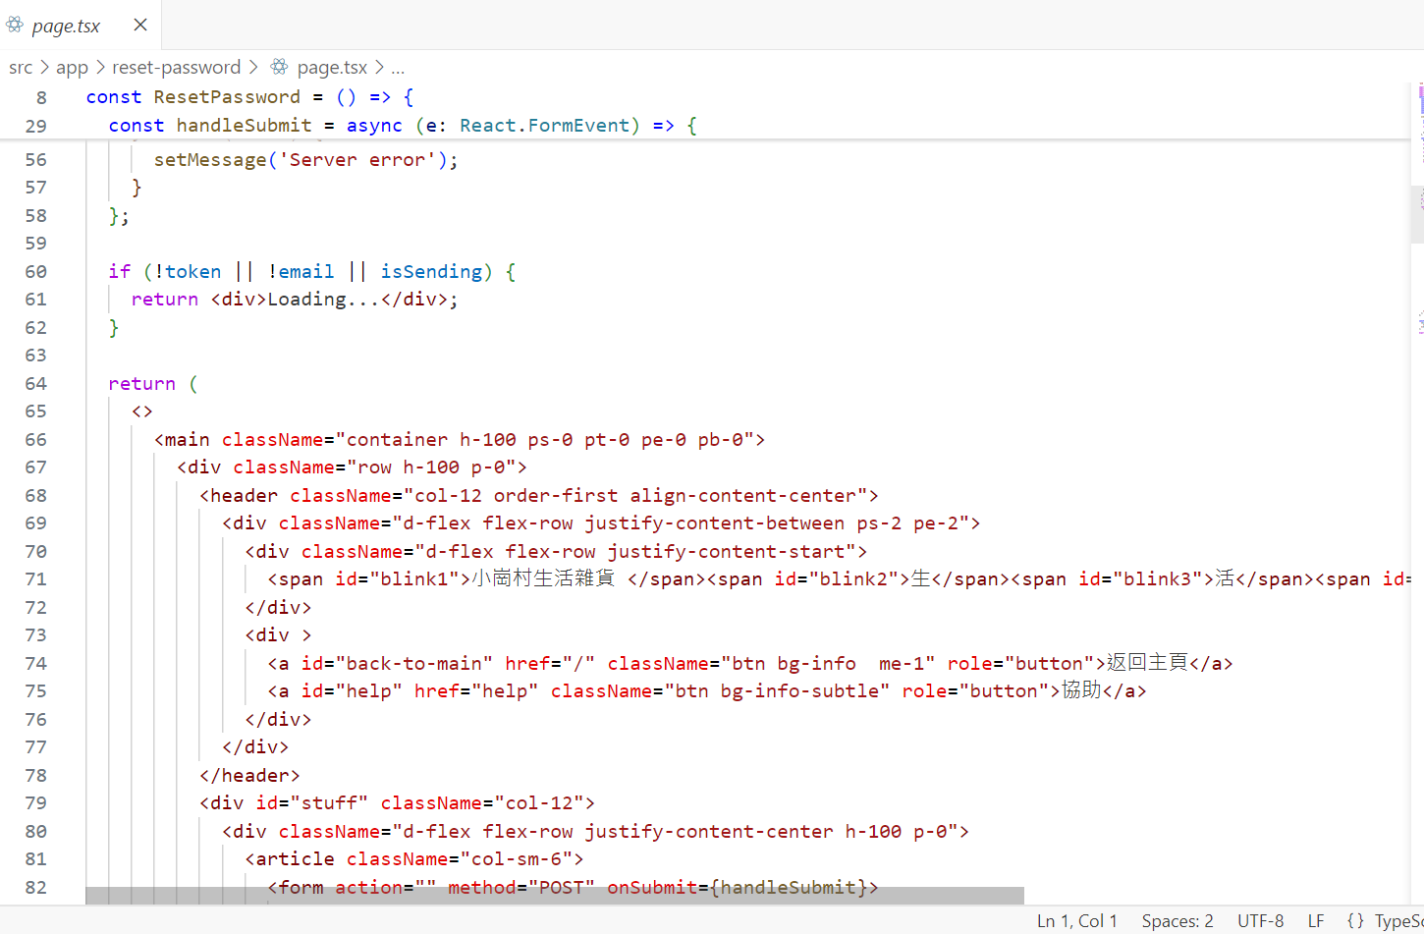
reset password

Slide 45
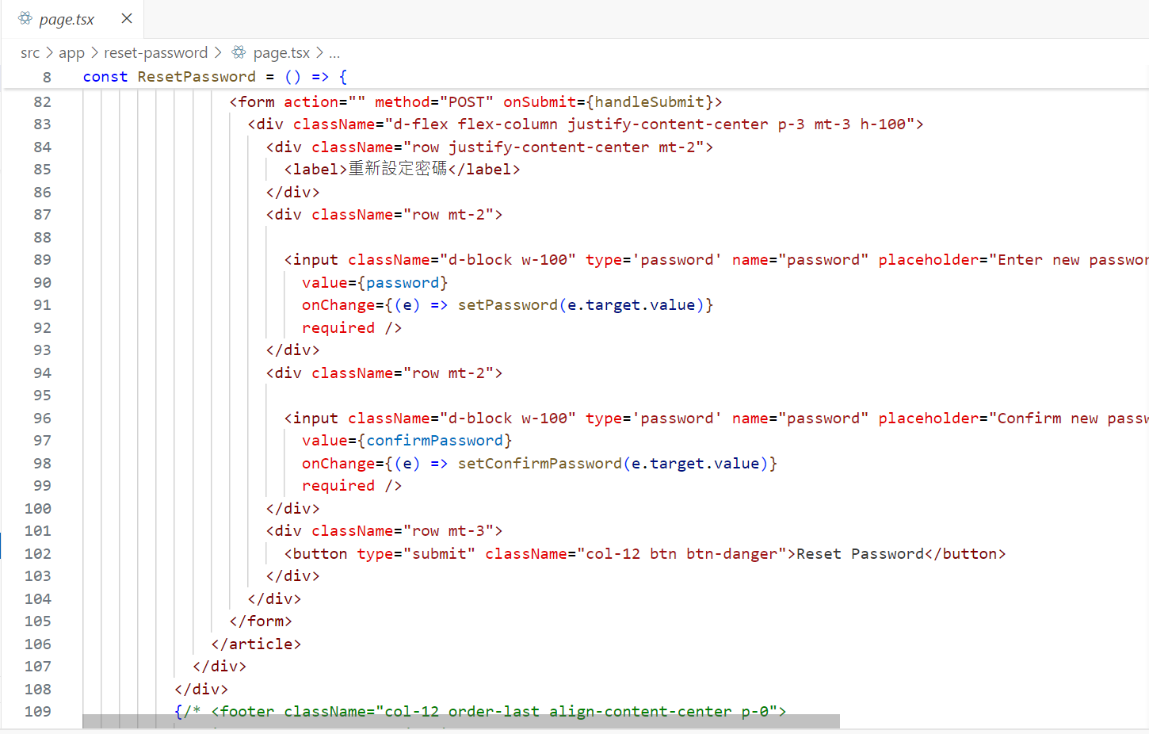
reset password

Slide 46
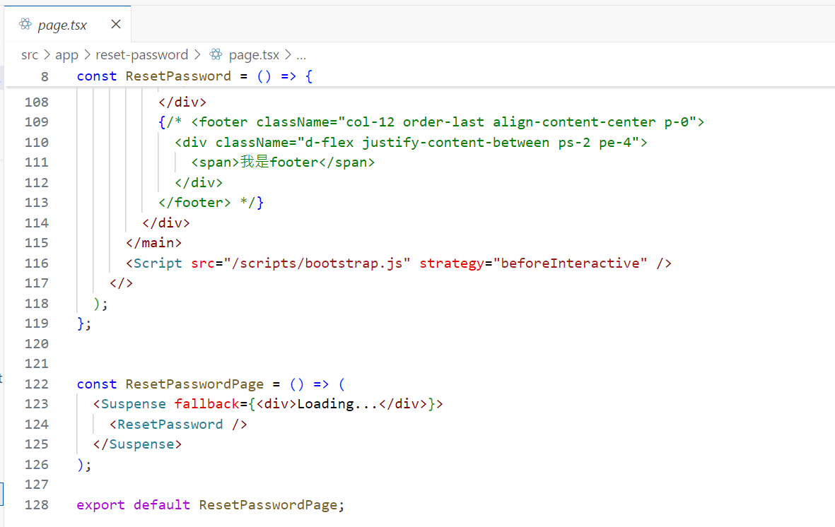
reset password

Slide 47
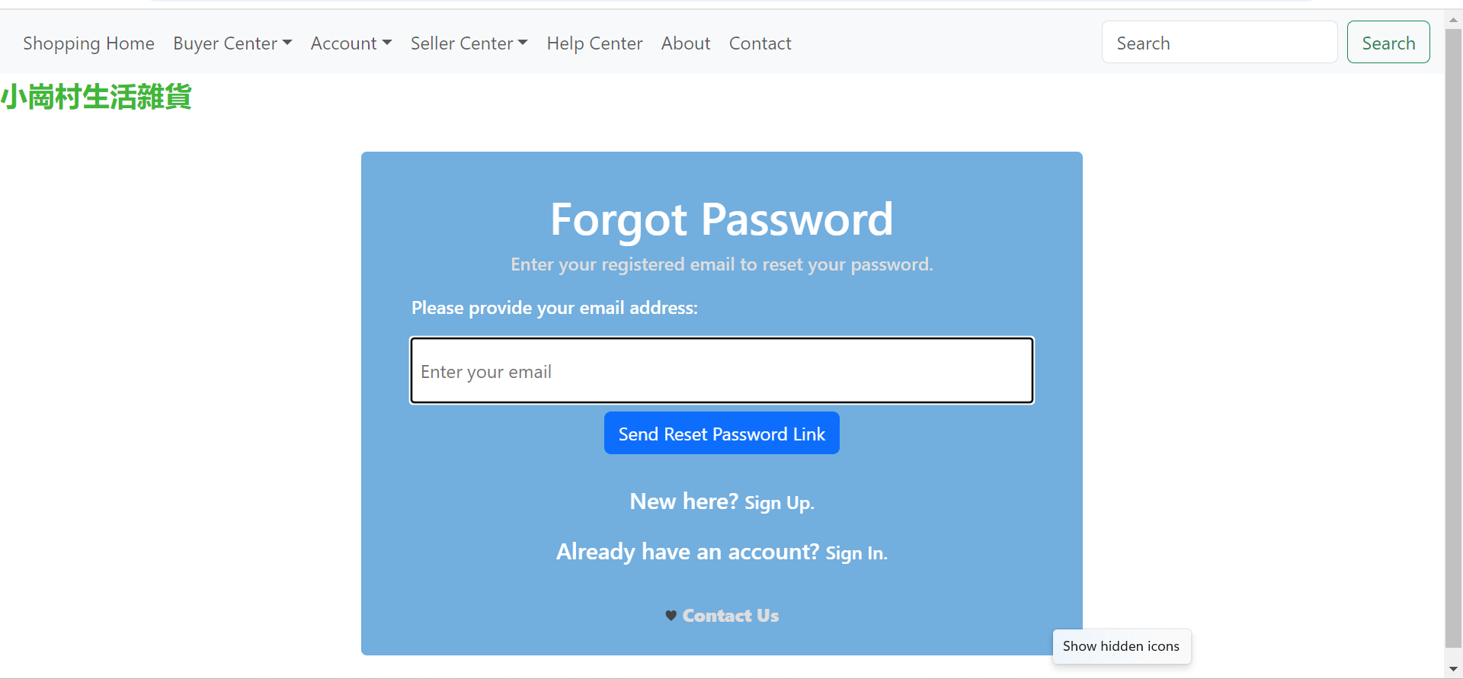
forgot password

Slide 48
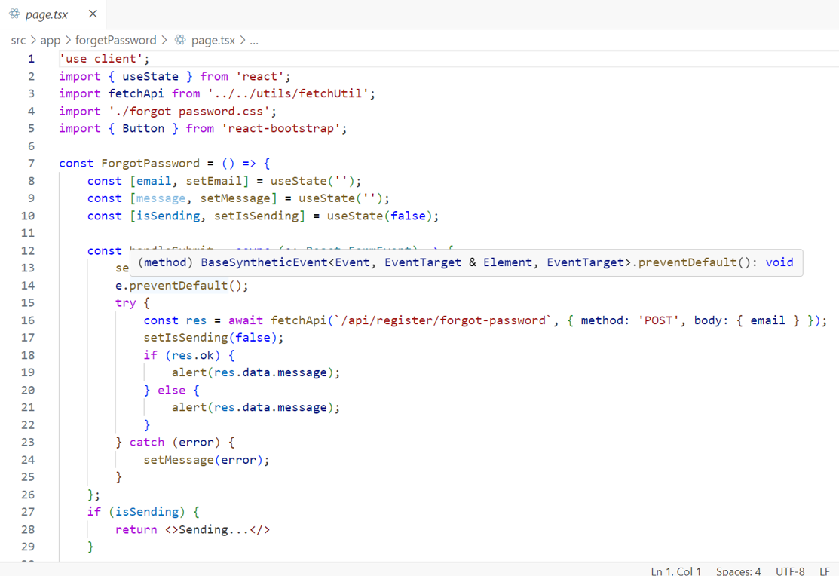
forgot password

Slide 49
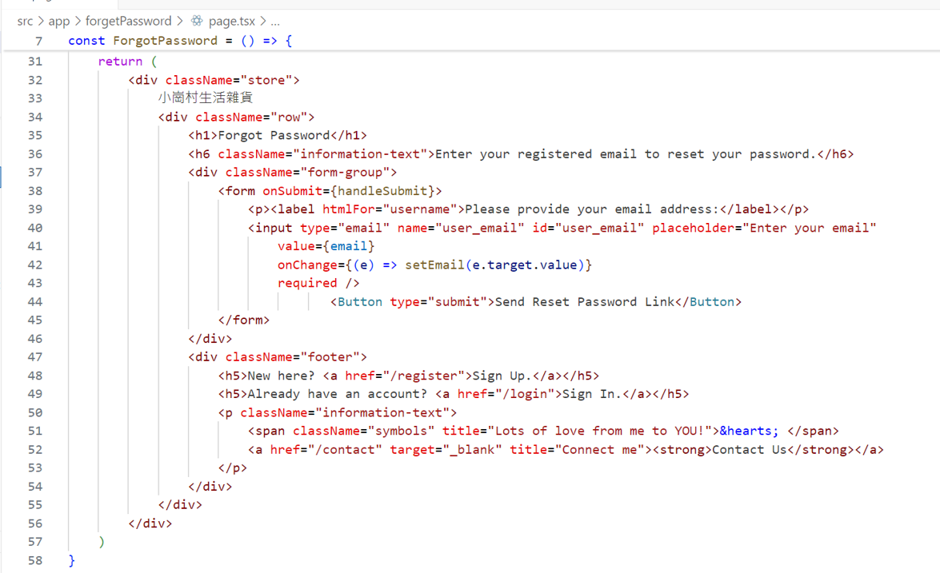
forgot password

Slide 50
分工
MUMIAN：backend。shopping home、cart、purchase history、browser history、publish new product、edit published product、product detail page。
Poon Kwok-hung: home page, login page, registration page, help page, fill in products detail.
Polly: about page, contact page, reset password page, forgot password page, add detail products to database.

Slide 51
thank you

